Slide 1
CS 540 Network Architecture
Wrap-up
Prof. Younghee Lee

Slide 2
Upcoming events!
www.microsoft.com/en-us/research/event/computing-21st-century-2016/
Nov. 3
https://www.ietf.org/meeting/97/
Nov. 14 ~ Nov. 18

Slide 3
Wrap up
Uncovered topics of TCP: fairness, performance
Scope of midterm exam.
e2e
Problem of the Internet
Mobility
IDR
Routers
RED
Fair queueing
TCP

Slide 4
Observed TCP Problems
Timeout >> fast rexmit
Need 3 dupacks/sacks
Not great for small transfers
Don’t have 3 packets outstanding
Too many small packets
Solution: Delayed ACKS
Don’t ACK data immediately
Wait 200ms (must be less than 500ms – why?)
Must ACK every other packet(full sized incoming segment)
Must not delay duplicate ACKs(why?)
reducing protocol overhead but reducing application performance
Silly Window Syndrome

Slide 5
Silly Window Syndrome
Problem: (Clark, 1982)
If receiver advertises small increases in the receive window(due to small available buffer size) then the sender may waste time sending lots of small packets => receiver can’t process all incoming data => almost buffer full => vicious cycle)
Silly window syndrome occurs when the window is almost full.
Solution
Receive-side silly window avoidance:(David Clack)
Receiver must not advertise small window increases
Increase window by min(MSS, RecvBuffer/2)

Slide 6
Silly window syndrome: Nagel’s Algorithm
Small packet problem:
Don’t want to send a 41 byte packet for each keystroke
1 byte of information + 40 bytes header : telnet session
How long to wait for more data?
Applications such as networked multiplayer video games?
use TCP_NODELAY (set to on) to bypass the Nagle delay.
Solution: Send-side silly window avoidance
The sender sends the first segment even if it is a small one. Then
The sender waits until an ACK is received or a maximum sized segment (MSS) is accumulated
keep buffering its output until it has a full packet's worth of output

Slide 7
Protection From Wraparound
Sequence Time Wraparound time vs. Link speed
1.5Mbps: 6.4 hours
10Mbps: 57 minutes
45Mbps: 13 minutes
100Mbps: 6 minutes
622Mbps: 55 seconds → < MSL!(Maximum Segment Lifetime ) 255sec
1.2Gbps: 28 seconds
Use timestamp to distinguish sequence number wraparound

Slide 8
Large Windows
Delay-bandwidth product for 100ms delay
equivalent to the maximum amount of data on the network circuit at any given time: Long Fat Networks(LFN) such as High Speed LAN or satellite link
1.5Mbps: 18KB
10Mbps: 122KB > max 16bit window : max. 65,535 bytes
45Mbps: 549KB
100Mbps: 1.2MB
622Mbps: 7.4MB
1.2Gbps: 14.8MB
Scaling factor on advertised window
TCP window scale option
Specifies how many bits window must be shifted to the left
Scaling factor exchanged during connection setup

Slide 9
Maximum Segment Size (MSS)
Exchanged at connection setup
Typically pick Maximum Transmission Unit (MTU) of local link
What all does this effect?
Efficiency
Congestion control
Retransmission
Path MTU discovery
IP Datagram Size: Maximum Transmission Unit (MTU)
Why should MTU match MSS?

Slide 10
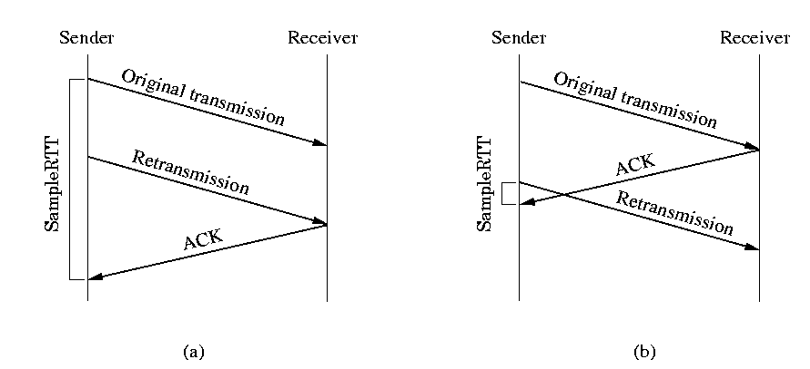
Retransmission timer management; Karn’s algorithm
Suppose that a segment times out and must be retransmitted.
An subsequent ACK can be the one to the first transmission of the segment
This can be ACK to the second transmission
TCP cannot distinguish
Karn’s algorithm.
Do not use the measured RTT for a retransmitted segment
Calculate the backoff RTO when a retransmission occurs
Use the backoff RTO until an ACK arrives without retransmission

Slide 11
Timer Granularity
Many TCP implementations set RTO in multiples of 200,500,1000ms
Why?
Avoid spurious timeouts – RTTs can vary quickly due to cross traffic
Make timers interrupts efficient

Slide 12
TCP Persist
TCP Persist state
If an acknowledgment is lost, we could end up with both sides waiting for the other
TCP persist timer
Sender periodically sends 1 byte packets
Why 1 byte?
Receiver responds with ACK even if it can’t store the packet

Slide 13
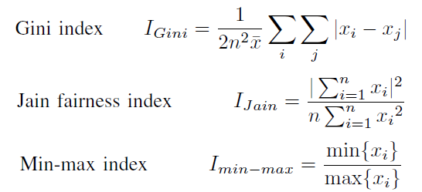
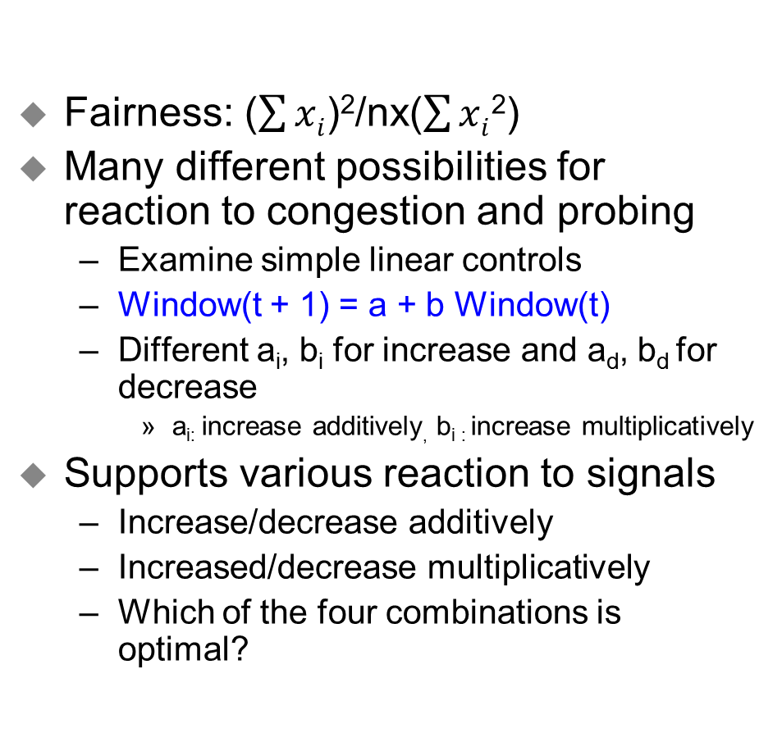
Fairness
Fairness: ($\sum{xi}$)²/nx($\sum{xi}$²)
Many different possibilities for reaction to congestion and probing
Examine simple linear controls
Window(t + 1) = a + b Window(t)
Different a_{i}, b_{i} for increase and a_{d}, b_{d} for decrease
a_{i:} increase additively, b_{i :} increase multiplicatively
Supports various reaction to signals
Increase/decrease additively
Increased/decrease multiplicatively
Which of the four combinations is optimal?

Slide 14
Phase plots
What are desirable properties?
X₂ = C –X₁
Fairness Line
C
Overload
User 2’s Allocation x₂
Optimal point
Underutilization
Efficiency Line
User 1’s Allocation x₁
C

Slide 15
Additive Increase/Decrease
Both X₁ and X₂ increase/decrease by the same amount over time
Additive increase improves fairness and additive decrease reduces fairness
Fairness Line
T₁
User 2’s Allocation x₂
T₀
Efficiency Line
User 1’s Allocation x₁

Slide 16
Multiplicative Increase/Decrease
Both X₁ and X₂ increase by the same factor over time
Extension from origin – constant fairness
Fairness Line
T₁
User 2’s Allocation x₂
T₀
Efficiency Line
User 1’s Allocation x₁

Slide 17
Constraints
Distributed efficiency
I.e.,  Window(t+1) >  Window(t) during increase
a_{i} > 0 & b_{i} ≥ 1
Similarly, a_{d} < 0 & b_{d} ≤ 1
Must never decrease fairness
a & b’s must be ≥ 0
a_{i}/b_{i} > 0 and a_{d}/b_{d} ≥ 0
Full constraints
a_{d} = 0, 0 ≤ b_{d} < 1, a_{i} > 0 and b_{i} ≥ 1

Slide 18
What is the Right Choice?
Constraints limit us to AIMD
Can have multiplicative term in increase (MAIMD)
AIMD moves towards optimal point
x₁
Fairness Line
x₀
User 2’s Allocation x₂
x₂
Efficiency Line
User 1’s Allocation x₁

Slide 19
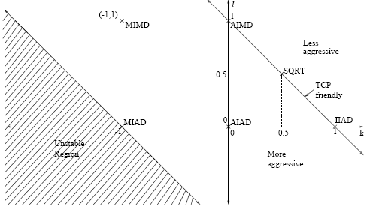
Binomial Congestion Control[Bansal01]
In AIMD
Increase: W_{n+1} = W_{n} + 
Decrease: W_{n+1} = (1- ) W_{n}
In Binomial: non linear congestion control
Increase: W_{n+1} = W_{n} + /W_{n}^{k}
Decrease: W_{n+1} = W_{n} -  W_{n}^{l}
k=0 & l=1 → AIMD,
k=-1 & l=1 → MIMD,
k=-1 & l=0 → MIAD,
k=0 & l=0 → AIAD
=> covering the class of all linear algorithm
l < 1 results in less than multiplicative decrease
Good for multimedia applications
k=1 & l=0 → IIAD (Inverse-Increase/Additive-Decrease), for TCP-friendly Congestion Control for Real-time Streaming Applications
k & l= 0.5 → SQRT,

Slide 20
Binomial Congestion Control
Rate ~ 1/ (loss rate)^{1/(k+l+1)}
If k+l=1 → rate ~ 1/p^{0.5} (Why? See next “Simple Loss Model)
TCP friendly if k+l ≤ 1
AIMD (k=0, l=1) is the most aggressive of this class
Good for applications that want to probe quickly and can use any available bandwidth

Slide 21
TCP Connection Management
Recall: TCP sender, receiver establish “connection” before exchanging data segments
initialize TCP variables:
seq. #s
buffers, flow control info (e.g. RcvWindow)
client: connection initiator
Socket clientSocket = new Socket("hostname","port number");
server: contacted by client
Socket connectionSocket = welcomeSocket.accept();
Three way handshake:
Step 1: client end system sends TCP SYN control segment to server
specifies initial seq #
Step 2: server end system receives SYN, replies with SYNACK control segment
ACKs received SYN
allocates buffers
specifies server-> receiver initial seq. #
Step 3: client receives SYNACK, replies with ACK segment, which may contain data

Slide 22
TCP Performance Issues
Consistently full queues can degrade TCP performance.
Lock out of some sessions
Synchronization of TCP sessions due to the dropping of bursts of packets
Penalizing of bursty flows
Increased queueing delay
Not all users sharing a bottleneck link get the same bandwidth.
Can be considered to be unfair
Malicious users can grab more bandwidth by modifying TCP or by using UDP.
Again a fairness issue - very hard problem

Slide 23
TCP Modeling
Given the congestion behavior of TCP can we predict what type of performance we should get?
What are the important factors
Loss rate
Affects how often window is reduced
RTT
Affects increase rate and relates BW to window
RTO
Affects performance during loss recovery
MSS
Affects increase rate

Slide 24
Transmission Rate
What is area under curve?
W = pkts/RTT, T = RTTs
A = avg window * time = ¾ W * T
What was bandwidth?
BW = A / T = ¾ W
In packets per RTT
Need to convert to bytes per second
BW = ¾ W * MSS / RTT
What is W?
Depends on loss rate
Packets transferred
Assumption: no timeouts and perfect loss recovery
W
W/2
Time

Slide 25
Simple Loss Model
What was the loss rate?
Packets transferred between the packet loss
(¾ W/RTT) * (W/2 * RTT) = 3W²/8
¾ W/RTT: number of packets per sec
W/2 * RTT: time between the packet loss
1 packet lost → loss rate : p = 8/3W²
BW = ¾ * W * MSS / RTT
Additional assumptions
Fixed RTT
No delayed ACKs
Each RTT window increases by 1 packet
→W/2 * RTT before next loss
W
¾ W
W/2
W/2
Time

Slide 26
Wrap up
Uncovered topics of TCP: fairness, performance
Scope of midterm exam.
e2e
Problem of the Internet
Mobility
IDR
Routers
RED
Fair queueing
TCP

Slide 27
e2e
What is the motivation of the e2e principle?
Comparison with Telco data networking paradigm
Why do “soft state” and “fate sharing” concepts so well for high survivability that is one of the Internet design goals.

Slide 28
Wrap up
Uncovered topics of TCP: fairness, performance
Scope of midterm exam.
e2e
Problem of the Internet
Mobility
IDR
Routers
RED
Fair queueing
TCP

Slide 29
Problem of the Internet
Problems of the e2e principle?
Inefficiency
End hosts do the network level functions such as retransmission, congestion control
Difficulties to implement some functions which need network level control information
Inappropriate implementation hurt the network as well as the hosts
Greedy sources aren’t handled well ⬅
Weak accounting and pricing tools
Weak administration and management tools
Incremental deployment difficult at times
Rethinking the design of the Internet
Tussle design?
Performance comparison in terms of error/congestion control and easiness of network design and evolution

Slide 30
Wrap up
Uncovered topics of TCP: fairness, performance
Scope of midterm exam.
e2e
Problem of the Internet
Mobility
IDR
Routers
RED
Fair queueing
TCP

Slide 31
Mobility
mobility problem of each layer
Basic reason of ip mobility problem? Possible solutions?
HIP, LISP, ILNP, i3
Advantages and disadvantages?

Slide 32
Wrap up
Uncovered topics of TCP: fairness, performance
Scope of midterm exam.
e2e
Problem of the Internet
Mobility
IDR
Routers
RED
Fair queueing
TCP

Slide 33
IDR
BGP growth problems? How to limit growth?
Address fragmentation: Most significant
Multi-homing: Increasing over time
Load balancing: Increasing over time
Failure to aggregation
Policies?
Machine learning to solve?
SDN? IPv6?

Slide 34
Wrap up
Uncovered topics of TCP: fairness, performance
Scope of midterm exam.
e2e
Problem of the Internet
Mobility
IDR
Routers
RED
Fair queueing
TCP

Slide 35
Routers
Head of line blocking problem? Solution?
smaller buffers in backbone routers? Why?

Slide 36
Wrap up
Uncovered topics of TCP: fairness, performance
Scope of midterm exam.
e2e
Problem of the Internet
Mobility
IDR
Routers
RED
Fair queueing
TCP

Slide 37
RED
Full queues problem?, Lock-out phenomena?
Random Exponential Marking (REM)
Flow (Fair) Random Early Drop (FRED)
Comparison: RED, REM, FRED

Slide 38
Wrap up
Uncovered topics of TCP: fairness, performance
Scope of midterm exam.
e2e
Problem of the Internet
Mobility
IDR
Routers
RED
Fair queueing
TCP

Slide 39
Fair queueing
Max-Min Fair Share
Problem of Weighted Fair Queuing(WFQ)
WF²Q: Worst-case Fair Weighted Fair Queueing
Core-Stateless Fair Queueing
Mis-behaving flows? Role of edge router to this? Core router?

Slide 40
Wrap up
Uncovered topics of TCP: fairness, performance
Scope of midterm exam.
e2e
Problem of the Internet
Mobility
IDR
Routers
RED
Fair queueing
TCP

Slide 41
TCP
three ways for packet conservation to fail: solutions?
The connection doesn’t get to equilibrium
A sender injects a new packet before an old packet has exited
Self clocking?
The equilibrium can’t be reached because of resource limits along the path.
Slow start for short lived flow? Solution?
TCP-RENO, TCP-SACK
Fairness : AIMD
=================================
BIC-TCP(flows with very different RTTs), CUBIC
TFRC problems?

Slide 42
TCP
TCP vega
TCP westwood: why is it good for both wired & wireless networks?, TCPW with snoop?
TCP/UDP in Mobile Ad Hoc Networks
Mobility, stale route information, link failure

